Slide 1

Introduction to e-commerce

Slide 2
e-commerce
E-commerce involves the use of the Internet, the World Wide Web (Web), and mobile apps and browsers running on mobile devices to transact business.
Digitally enabled transactions include all transactions mediated by digital technology
Commercial transactions involve the exchange of value (e.g., money) across organizational or individual boundaries in return for products and services

Slide 3
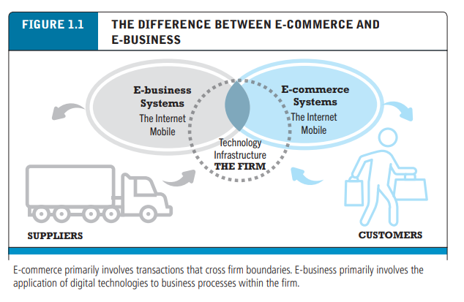
e-commerce vs e-business
e-commerce is not “anything digital” that a firm does.
e-business refers primarily to the digital enabling of transactions and processes within a firm, involving information systems under the control of the firm.
e-business does not include commercial transactions involving an exchange of value across organizational boundaries.

Slide 4
Eight Unique Features of E-commerce Technology
Ubiquity
Global reach
Universal standards
Information richness
Interactivity
Information density
Personalization/customization
Social technology

Slide 5
UBIQUITY
It is available just about everywhere and at all times.
Market Place vs Market Space
Reduce Cognitive Energy (Advantage)
Examples:-
Accessing a bank account (24/7)
Purchasing from Internet.
Online Tracking
Online Ticket Reservation
Paying Utility Bills

Slide 6

GLOBAL REACH
Reach: the number of user or customers an e-commerce business can obtain.
Traditional Commerce base on Television , Radio, Newspaper and Sales force.
Using Internet Commercial transactions to cross cultural and national boundaries
Examples:-
300 million customers | http://www.amazon.com/
2.9 billion Active Users | http://www.facebook.com/
Growing Mobile Social Network

Slide 7

UNIVERSAL STANDARDS
Standards (i.e. INTERNET) shared by all nations around the world
Traditional commerce technologies differ from one nation to the next ( Radio, Newspaper, TV ) etc.
Using Internet Commercial transactions to cross cultural and national boundaries
Benefits of Universal Standards
Reduced search costs for consumers| http://www.google.com/
simpler, faster, with more accurate price discovery
Lower market entry costs for merchants
find many of the suppliers, prices, and delivery terms of a specific product

Slide 8

RICHNESS
The complexity and content of a message
Traditional commerce national sales forces, and small retail stores have great richness face-to-face service using aural and visual cues when making a sale.
But there is Trade-off between richness and reach
Benefits of Richness
more information richness than traditional media
chatting with an online customer support person
sell ‘complex’ goods and services
Compare All (Prices, attributes, Services etc)
Notes:
A trade-off (or tradeoff) is a situation that involves losing one quality or aspect of something in return for gaining another quality or aspect.

Slide 9
INTERACTIVITY
Communication between the merchant and the consumer.
Traditional commerce national sales forces, and small retail stores have great richness face-to-face service using aural and visual cues when making a sale.
Interactivity in E-Commerce
Customer Support
Customer Reviews
Feedback, FAQ’s, Newsletter Option
E-mail Support
Live Help with customer representative

Slide 10

INFORMATION DENSITY
Total amount and quality of information available to all market participants
Internet and the web vastly increase information density.
Ecommerce technologies reduce information collection, storage, processing, and communication costs.
Due to E-commerce Technologies information becomes more plentiful, less expensive and of higher quality.
Go to Amazon, Ebay or wallmart website you can find verity of products and prices.
Growth in information density could result in
Greater price transparency- for customers
Greater Cost transparency- for customers
Marketers to practice price discrimination (Segmentation)

Slide 11


PERSONALIZATION & CUSTOMIZATION
PERSONALIZATION: The targeting of marketing messages to specific individuals.
by adjusting the message to a person’s name, interest, and past purchases.
Examples:- 1. Product search history on amazon.com
2. Welcome message by name on Gmail.
CUSTOMZATION: Changing the delivered product or service by Customer.
Examples:- 1. Add Text or Images not included in the original design
2. Customize a laptop on Dell.com.
3. Add Text , Color to customize Shirts.

Slide 12


SOCIAL TECHNOLOGY
User content generation and social networking technologies.
socializing traditional e-commerce sites by integrating social elements into existing retail websites.
Social technologies are increasingly being used to connect with customers to build strong and lasting relationships, through ratings and reviews, blogs, Wiki’s, micro-blogging, forums and communities like Facebook.
Social Media Examples
Facebook | plugins integration
Twitter | plugins integration
Pinterest | plugins integration
Google+ | plugins integration
Notes:
Engaging customers based on their social behavior with your brand
Providing customers with a reason to return to your website
Giving clients a reason to talk about your brand on your website
Providing all the necessary information on your website for your clients to research, compare, make a decision and purchase from you and not your competitor

Slide 13
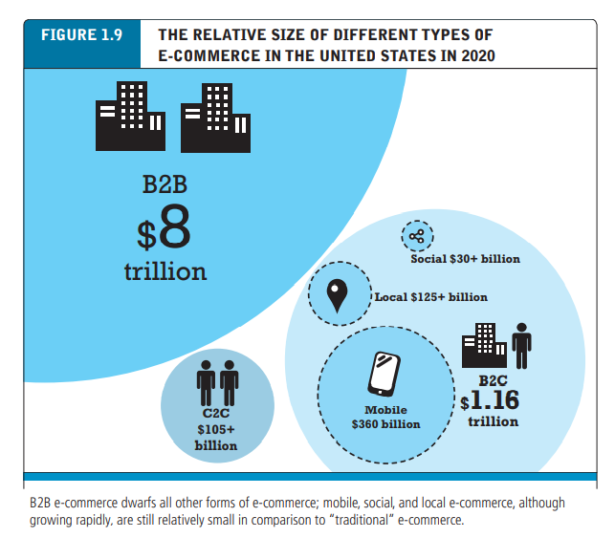
Types of e-commerce
Business-to-Consumer: Amazon
Business-to-Business: Metalshub
Consumer-to-Consumer: e-bay
Mobile e-commerce
Social e-commerce: Telegram
Local e-commerce: Groupon

Slide 14

e-commerce themes
Technology— the Internet, the Web, and mobile platform, and a host of complementary technologies—cloud computing, desktop computers, smartphones, tablet computers, local area networks, client/server computing, packet-switched communications, protocols such as TCP/IP, web servers, HTML, and relational and non-relational databases, among others.
Business—electronic markets, information goods, business models, firm and industry value chains, industry structure, and consumer behaviour in digital markets. While technology provides the infrastructure, it is the business applications—the potential for extraordinary returns on investment—that create the interest and excitement in e-commerce.
Society—intellectual property, individual privacy, and public policy, etc

Slide 15
Reading Assignment
Laudon and Traver (2021) E-commerce 2020-21 (16th ed.); E-commerce: A brief History; PP 63-73.
How to Write a Case Study: Bookmarkable Guide & Template. Braden Baker. https://blog.hubspot.com/blog/tabid/6307/bid/33282/the-ultimate-guide-to-creating-compelling-case-studies.aspx

